Slide 1

A Project Stage-II on Design And Development Of Auto Solar Panel Cleaning With Water Spraying System Presented By Tushar Shingade (B150311012) Nikhil Sangule (B150310976) Rushikesh More (B150310928) Abhishek Mase (B150310922) Guided By Prof. P. S. Pawar
PES’s Modern College of Engineering
Department of Mechanical Engineering
Academic Year
2021-22

Slide 2

Content
Introduction
Literature Review
Problem Definition
Future Scope
Objectives
Components
Mathematical Work
CATIA Design
Results and Discussion
Graph
Conclusion
References.

Slide 3


Introduction
Solar power is the fastest growing means of renewable energy production with grid connected solar capacity increasing on average by 60 % annually from 2004 to 2009 according to the National Center for Policy Analysis.
There is more than enough solar radiation available around the world to satisfy the demand for solar power systems.
The proportion of the sun's rays that reach the earth's surface is enough to provide for global energy consumption 10,000 times over.
On average, each square meter of land is exposed to enough sunlight to produce 1,700 kWh of power every year.
Solar Panel has a huge effect on our world. It can helps our environment to be better without using other power generation plants that can harm the environment, but solar power plant needs to be cleaned at least every 3 days.
There are a lot of techniques for cleaning the solar panels; our idea is to design a smart solar panel that cleans itself automatically and remotely in order to maintain a high level of efficiency of the solar panel.

Slide 4

Literature Review
Sr No. | Author | Title | Publication Date | Journal | Summary
1 | Tennessee Valley Authority & Neil Vincent PLACER | Solar Photovoltaic panel Cooling System And Method | Mar. 6, 2014 (US 2014/0060620 A1) | United States Patent Application Publication | This paper is the first original base paper which was implemented in 2014 or idea came out for cooling as well as cleaning of system in united states. For increasing demand of potential energy towards the growth of EV’s.
2 | Rajiv Kumar Gurjwar | Automated Solar Panel Cleaning System using IoT | e-ISSN: 2395-0056 04 | Apr 2019 | International Research Journal of Engineering and Technology (IRJET) | In This project the aim was to develop for the betterment of the solar panel users. We providing transparency in cleaning system by using the most newly invented technology, which provide a better performance, integrity, consistency, cost-effective and scalable solution for the removal of dust and speck. The author had mentioned that with his cooling and cleaning technique about 36 % of energy is elongated with its efficiency

Slide 5
Literature Review
3 | Ram Jatan Yadav, Lakshay Saini, Devashish, Rishabh Tomar, Vipul Rana | Domestic Solar Panel Cleaning System and effect of Environmental Dust in PV Modules | ISSN: 2277-3878, Volume-9 Issue-2, July 2020 | International Journal of Recent Technology and Engineering (IJRTE) | In this research paper, A new way of approach to the domestic solar panel cleaning system, researchers have proposed many ways to improve and classify the object and present it in an image in the past. However, there have few projects related to domestic cleaning of solar panels.
4 | Nagesh Maindad | Automatic Solar Panel Cleaning System | 9 Jul 2020 (ICCIP) 2020 | International Conference on Communication & Information Processing | This paper is about the cleaning of a solar panel. In rural areas, most of the solar street lights are used. After the installation of the solar street light, it only works for two to three months. After that energy efficiency reduces. So measure regarding street light panels

Slide 6
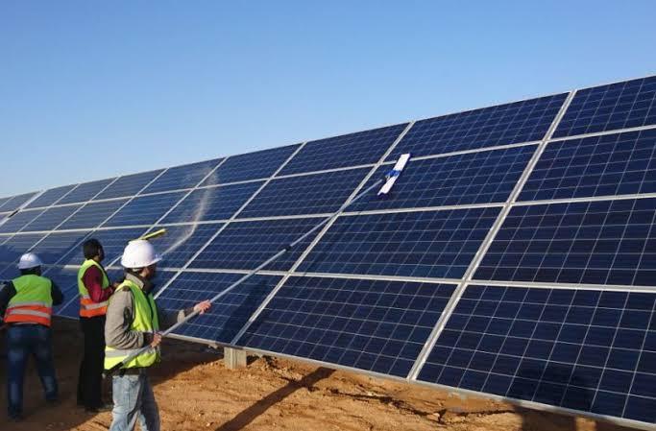
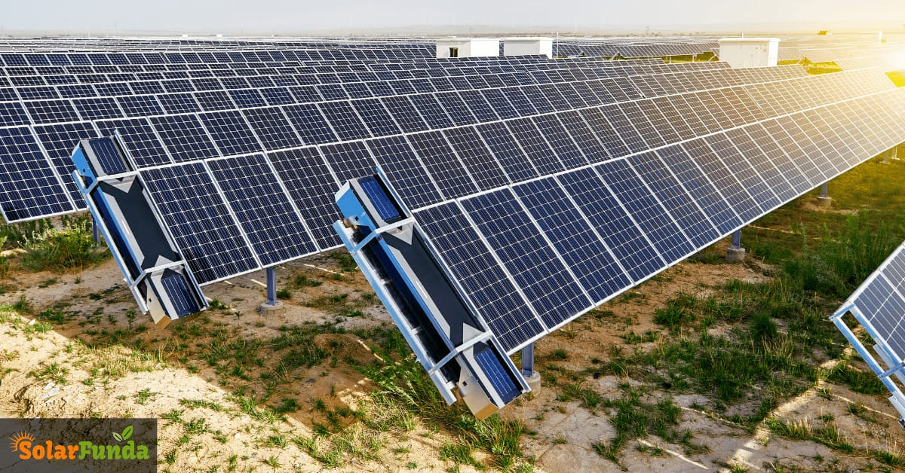

Slide 7

Problem Definition
The solar PV modules are generally employed in dusty environments which are the case tropical countries like India.
The dust gets accumulated on the front surface of the module and blocks the incident light from the sun.
It reduces the power generation capacity of the module. The power output reduces as much as by 50% if the module is not cleaned for a month.
There are a lot of techniques for cleaning the solar panels; our idea is to design a smart solar panel that cleans itself automatically in order to maintain a high level of efficiency of the solar panel.

Slide 8

Objectives
Increase the efficiency of Solar panels using Panel cleaning systems .
To make the system automatic using Toggle Switch, to avoid the manual work.
To remove Sticky Dust by adding water sprayer
To overcome these unwanted effects we have to Design and Develop a Solar panel cleaning machine.

Slide 9
Components
Frame = Mild steel (1680*625)mm.
Solar panel = 12volts PV capacity.
Brush = fabric roller or thin cleaner
Nozzle = 3 quantity ,10 mm dia.
Pipe = Plastic 1mtr long ,10 mm dia.
Water motor = 1 quantity .
Controller = Toggle switch.
Battery = 12 volts capacity 1.5 Amp.
Bolts & Nut = as per requirement
Wheel = 4
Transmission = direct contact .

Slide 10
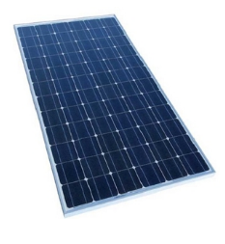
Components
Solar Panel :
Product: Polycrystalline Solar Panel
Rated Power Range: 1-100 W
Watt: 100 W
Voltage at Pmax ( V): 17.3 V
Module Voltage: 12 V
Number of Cells: 36
Module Dimension :(1040 x 625 x 35) mm
Cell Efficiency: 0.176

Slide 11
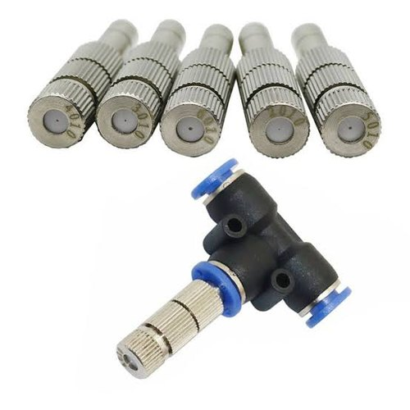

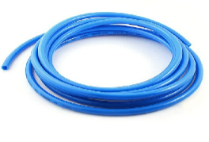
Components
Nozzle
Roller Brush
Pipe

Slide 12
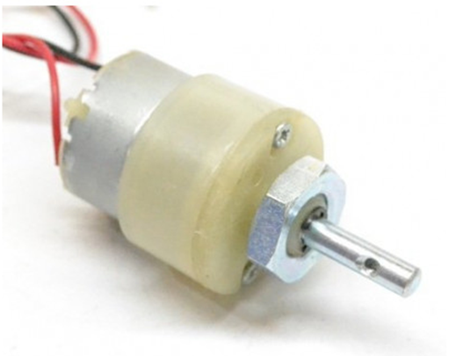
DC Motor
Specifications:
No. of pieces = 4
RPM = 30
Operating Voltage = 12V
Rated Torque = 5.7 Kg.cm
Stall Torque = 20.5 Kg.cm
Shaft diameter = 6 mm
Weight = 75 gm

Slide 13
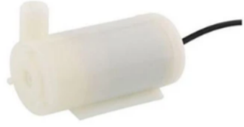
Water submersible motor
Specifications:
Material Engineering = Plastic
Operating Voltage = 5 V
Operating Current = 130 ~ 220mA
Flow Rate = 80 ~ 120 L/H
Continuous Working Life = 500 hours
Driving Mode DC, Magnetic Driving

Slide 14
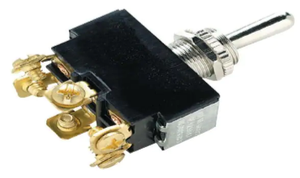
Switch
Toggle Switch.
It is also called as reverse and forward switch. It is used to change the direction of cleaning mechanism i.e. First forward then backward.

Slide 15
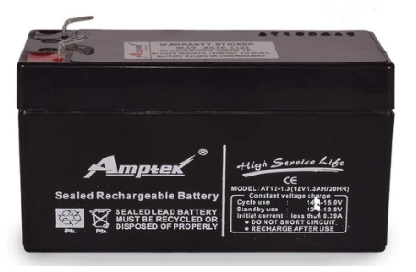
Battery
Specifications:
Material: plastic
Color: black
Pieces: 2
Volage: 12 V
Current: 5 A
Power: 54 W

Slide 16

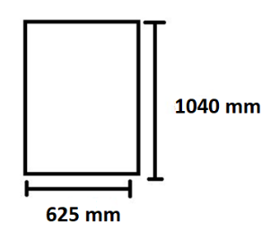
Mathematical Work
The material used for fabricating frame is Mild Steel.
An cross-section of 25*25*3 mm standard L angle plate.
F = force acting on total frame including all setups with motors, brush, clamp and shaft.
Weight of solar panel = 10 Kg approx.
Weight of Nozzle & arrangement = 3Kg
Other weight = 1Kg
Total Weight on the frame = 14 Kg
F.O.S = 2
Total weight = F.O.S *14 = 28Kg
Pd = Perpendicular distance of the frame which is 1040/2=520mm.
Design of Frame

Slide 17
We know,
M = Bending moment
I = Moment of Inertia about axis of bending that is; Ixx
y = Distance of the layer at which the bending stress is consider
Bending moment (M) = force *perpendicular distance
= 14Kg *9.81 * 520
M = 143000 N.mm
I = b(h^3) / 12
= 25*(25^3) / 12
I = 32552.0833 mm4
M / I = σb / y

Slide 18
Y = 25 / 2 = 12.5 mm
σb = unknown ?
σb = 54.91 N/mm2
The allowable shear stress for material is σallow = Syt / FOS
Where Syt = yield stress = 210 MPa = 210 N/mm2
And FOS is factor of safety = 2
So σallow= 210/2 = 105 MPa = 105 N/mm2
Comparing above we get,
σb < σallow i.e
54.91 < 105 N/mm 2
So design is safe.

Slide 19
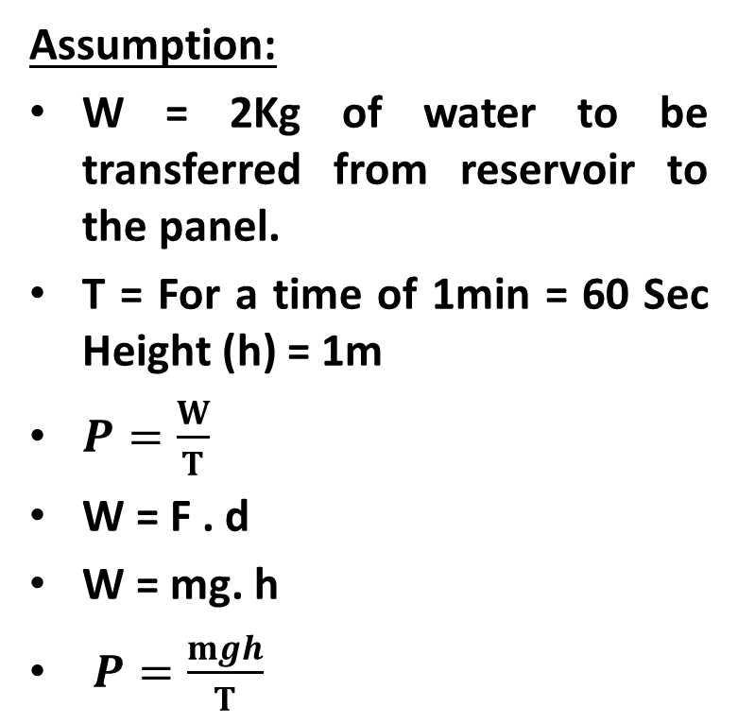
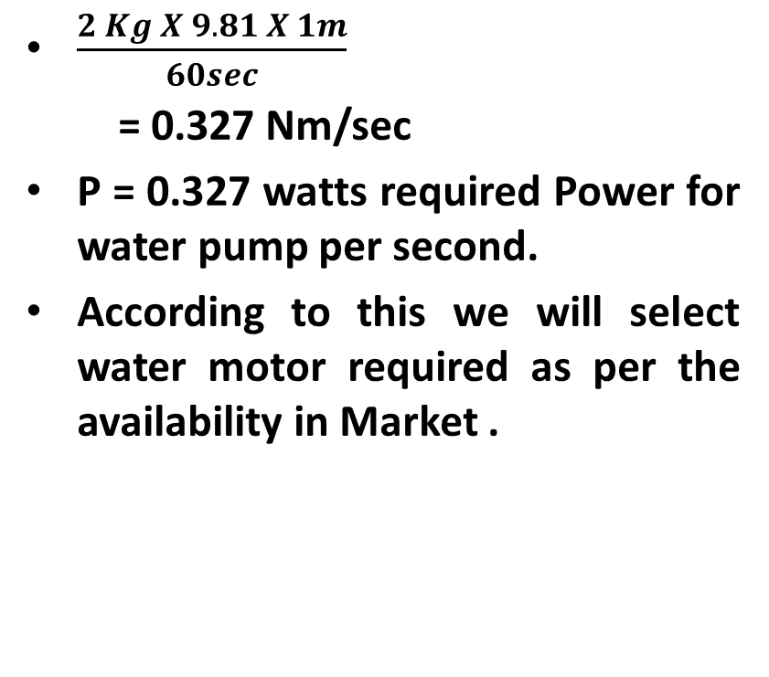
Hydraulic Pump Or Motor
Assumption:
W = 2Kg of water to be transferred from reservoir to the panel.
T = For a time of 1min = 60 Sec Height (h) = 1m
$P=\frac{W}{T}$
W = F . d
W = mg. h
$P=\frac{mgh}{T}$
$\frac{2 Kg X 9.81 X 1m}{60sec}$
= 0.327 Nm/sec
P = 0.327 watts required Power for water pump per second.
According to this we will select water motor required as per the availability in Market .

Slide 20

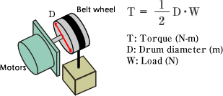
Motor Selection
Weight of the cleaning setup Nozzle, roller brush, shaft and arrangement W = 3 kg
D = diameter of wheel = 85 mm
W = 3 Kg = 3*9.81= 29.43N
T = 1/2 x 85 x 29.43
= 1263.525 N.mm
= 1.263 N.m
= 12.879 Kgf.cm
T =1263N.mm this torque is divide among 4 wheels.
So Torque required to drive the setup is , =Torque/no. of motors used
= 315.88 N.mm = 3.22 Kgf.cm
T = Torque = 1/2 D.W

Slide 21
Motor For Brush Rotation
Weight of the brush = 500 grams, assume = 4.905 N
Diameter of the roller brush= 10 mm
= ½ x 10 x 5
= 25 N.mm
= 0.025 N.m
T = 0.255 Kgf.cm
T = ½ .D .W

Slide 22

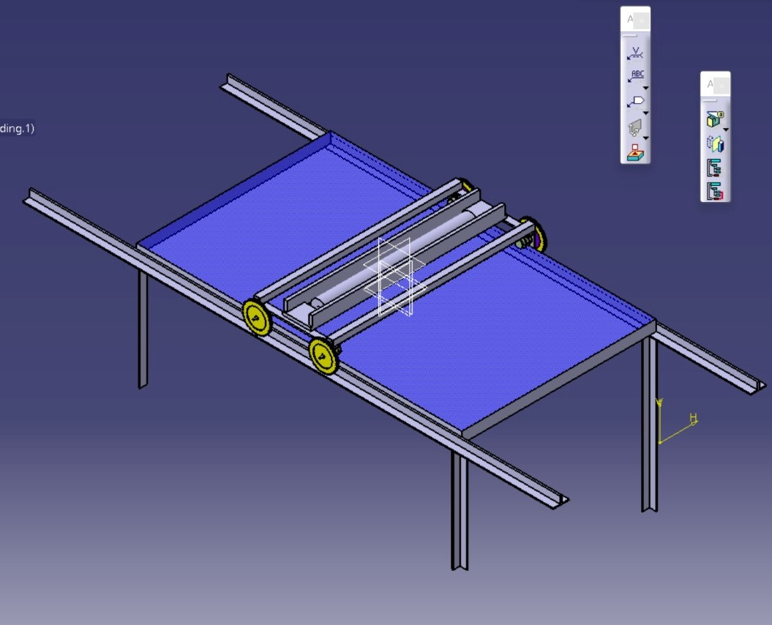
ISO CATIA V5 DESIGN

Slide 23
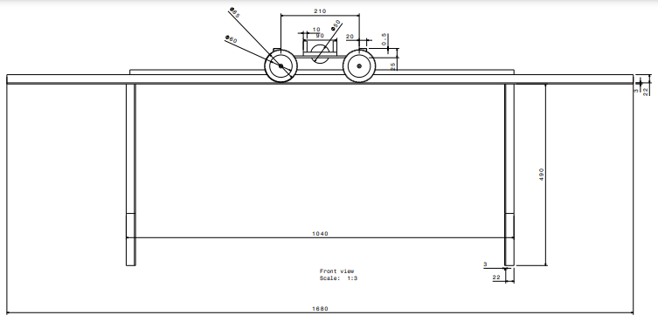
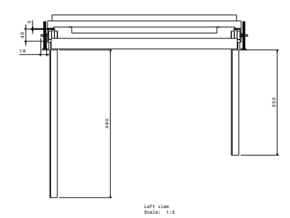
DRAFTING - Front And Side View

Slide 24
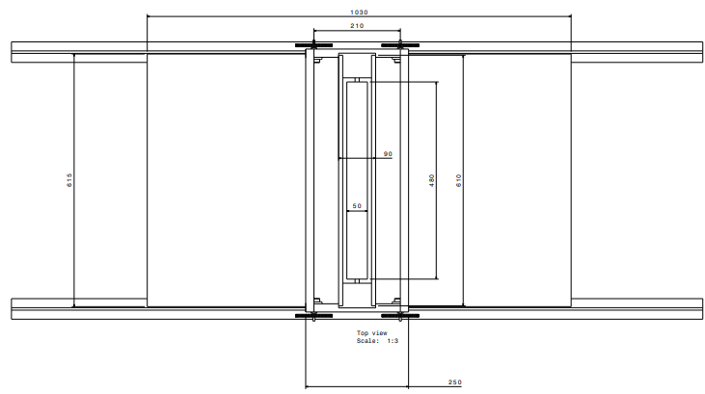
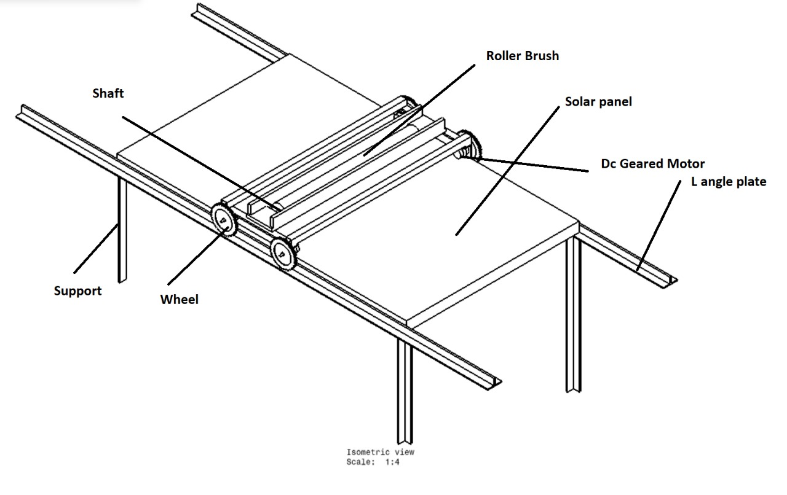
Drafted Top & ISO Drafted View

Slide 25

Future Scope
Automatic cleaning system is a innovative technology used to clean accumulated dust, dirt's etc.
For large scale solar plants, it requires highly man power, more time & a lot of capital expenditure.
In other hand, At Arduino controller with fixed initial cost and a little maintenances gives Better output than manual cleaning system.

Slide 26

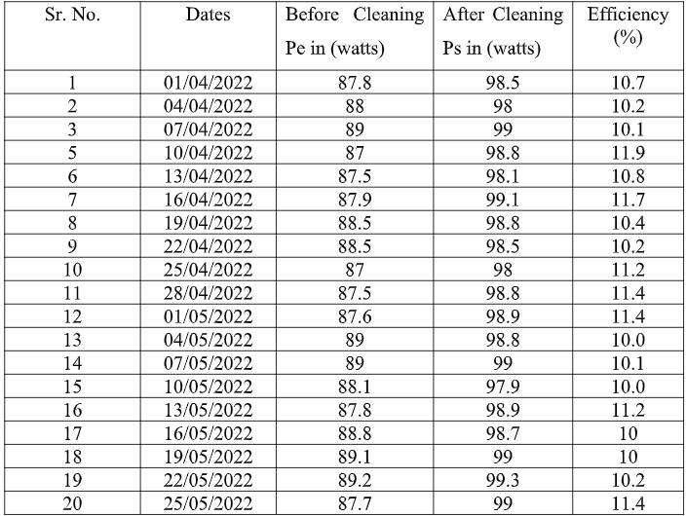
Results and Discussion
Efficiency = 100-[(Pe*100)/Ps]
Pe = Power before cleaning
Ps = Power after cleaning.
So, From table we can see Efficiency of a solar panel is increasing by approximately 10 % after cleaning regularly.

Slide 27
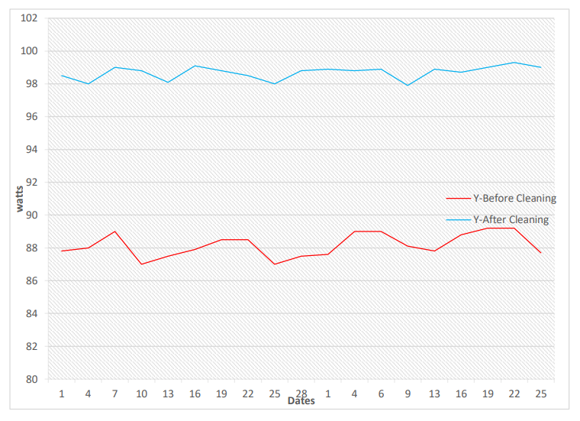
GRAPH
Fig: Graphical representation of power generation before and after cleaning the panel.

Slide 28
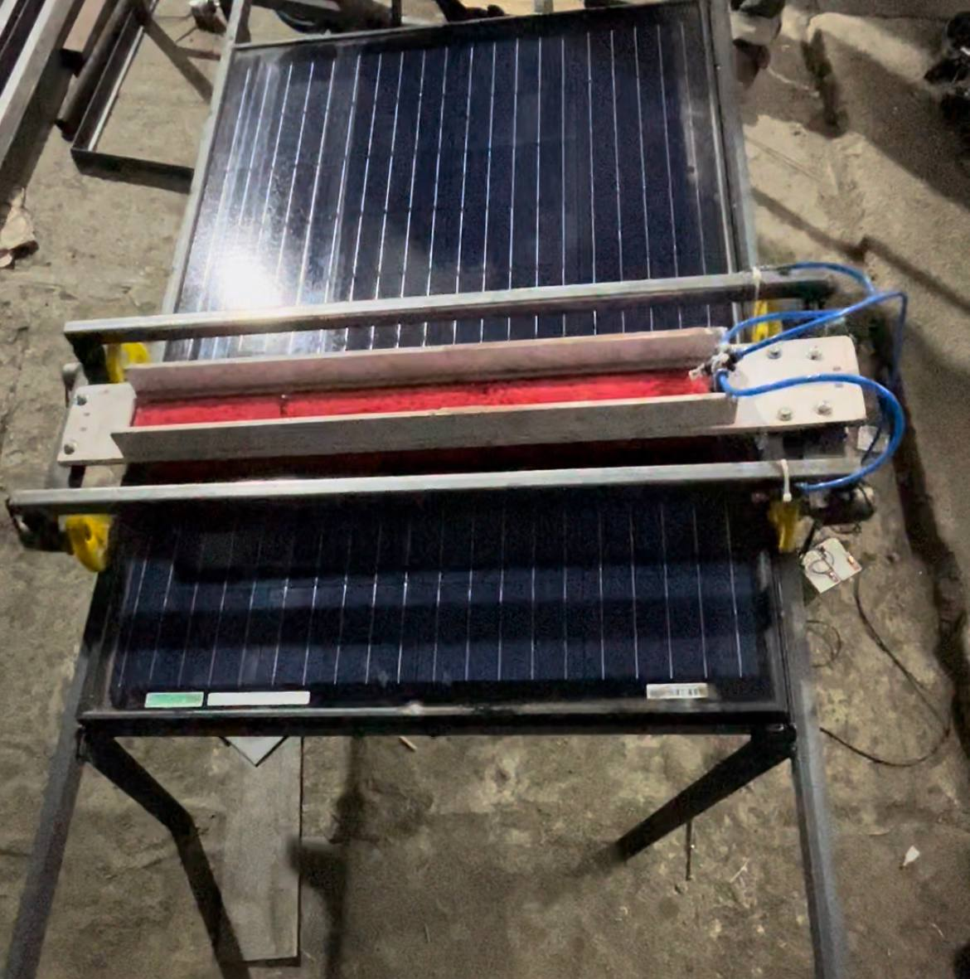
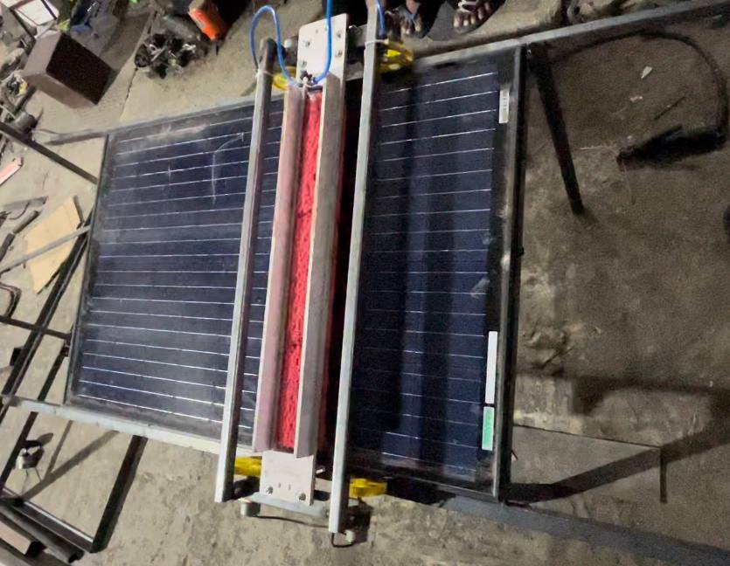
Experimental Setup Images

Slide 29
Bill Of Material
Sr. No | Parts and Specifications | Number Of Quantities | Cost In Rupee
1 | Solar Panel (1040*625*35) | 1 | 3500
2 | Water Motor | 1 | 150
3 | DC Motor | 4 | 600
4 | Frame (Mild Steel) | - | 500
5 | Roller Brush | 1 | 200
6 | Square Pipe | 1 | 100
7 | Toggle Switch | 1 | 100
8 | Battery | 2 | 600
9 | Battery Charger | 1 | 300
10 | Fabrication | - | 2300
11 | Transportation | - | 750
 | Total | = | 9100

Slide 30

Conclusions
By using this project we can clean solar panel effectively and regularly and increase the efficiency of solar panel by replacing conventional cleaning methods of the solar panel with the automation ,we can maintain the efficiency without affecting its performance.
Hence the design & fabrication of solar panel cleaning with water spraying system has been successfully designed & fabricated and the system is working as per the requirement.

Slide 31

References
[1] A. K. Mondal and K. Bansal, "A brief history and future aspects in automatic cleaning systems for solar photovoltaic panels," Advanced Robotics, vol. 29, no. 8, pp. 515-524, 2015.
[2] "Design and Development of Solar Panel Cleaning Machine", Dabhi Chirag, Gandhi Mayank, Jadeja Mandipsinh, Prajapati Parimal. International Journal of Advance Engineering and Research Development Scientific Journal of Impact Factor (SJIF): 4.72 Special Issue SIEICON-2017, April – 2017.
[3] M. Majumder et al., "Electrostatic removal of particles and its applications to self-cleaning solar panels and solar concentrators," in Developments in Surface Contamination and Cleaning: Elsevier, 2011, pp. 149-199.
[4] L.Dorobantu , M. Popescu, and C. Popescu, "Yield loss of photovoltaic panels caused by depositions," in Advanced Topics in Electrical Engineering (ATEE), 2011 7th International Symposium on, 2011, pp. 1-4: IEEE.
[5] "Improvement of Efficiency of Solar Panel Using Different Methods." Rupali Nazar MTech. Student, Department of Electrical and Electronics Engineering. Lingaya's University, Faridabad, (India). IJEEE, Volume 07, Issue 01, Jan- June 2015.

Slide 32

Thank You !
Any

